Slide 1
X-Ray Teeth Segmentation
Daniella Zunic, Robert Smithers, Yuting Ji

Slide 2
Objective
Notes:
why are we choosing the project;Our original plans for the project;

Slide 3


This challenge aims to identify teeth position and shape variation across subjects.
Challenge Specifications:
Predict the number of teeth in a 3D scan
Label the location of teeth in a 3D scan
Identify locations of missing teeth
Denti AI
Pearl
VideaHealth
Promethean

Slide 4
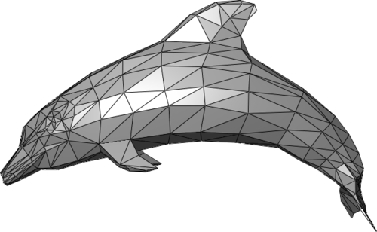

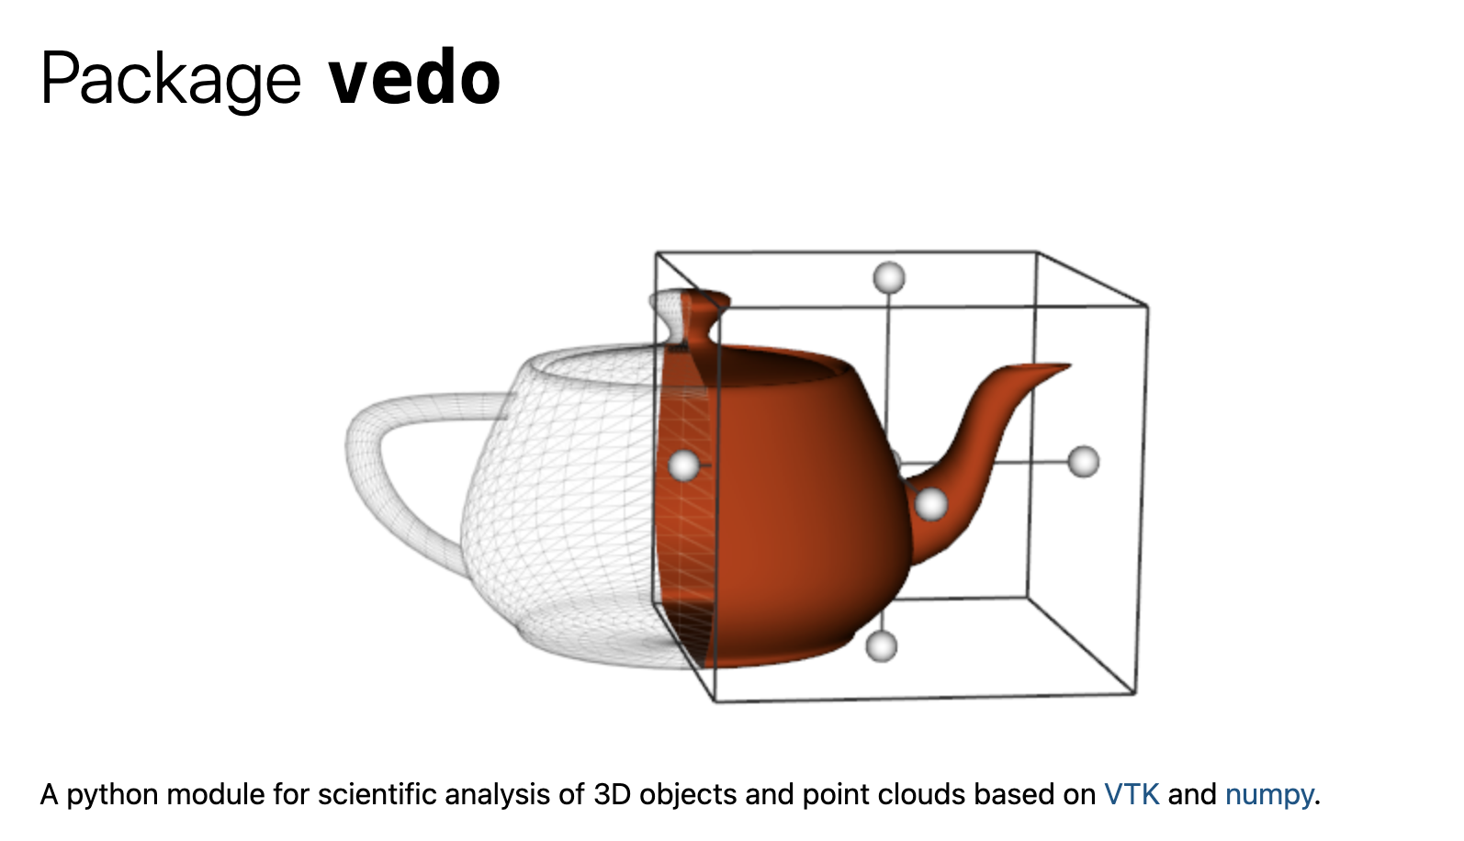
3D Data and Rendering
Mesh
Vertices
Faces
Textures
PyTorch 3D
Vedo
image from
https://pytorch3d.org/
image from
https://vedo.embl.es/autodocs/content/vedo/index.html
Notes:
Introduce what is mesh, brief discussion about pytorch3d and vedo

Slide 5
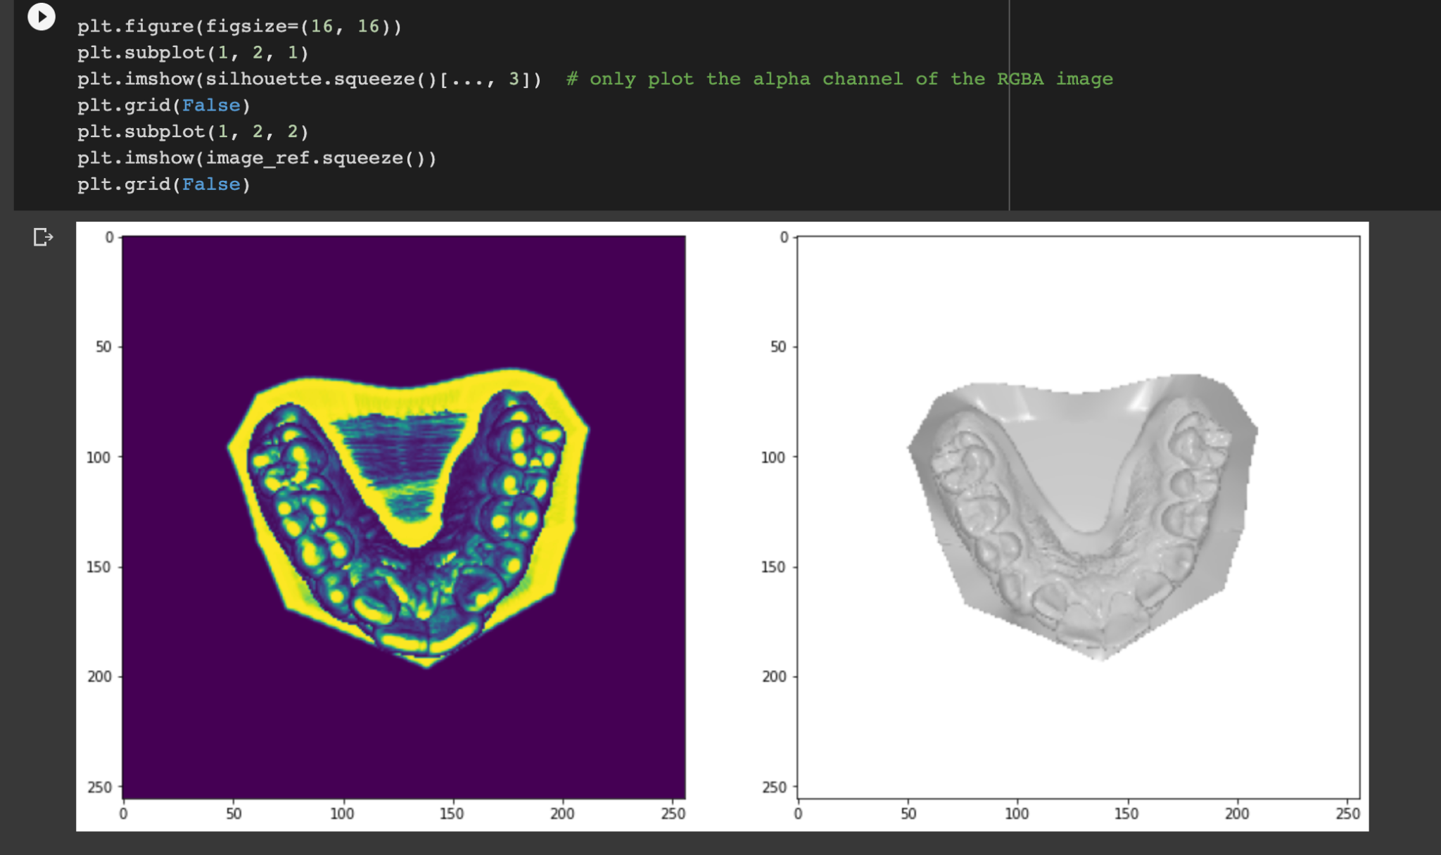
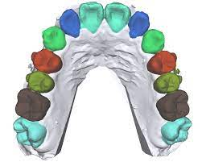
Notes:
An illustration of 3D implementation, apply segmented result as texture and apply to the original 3D object

Slide 6
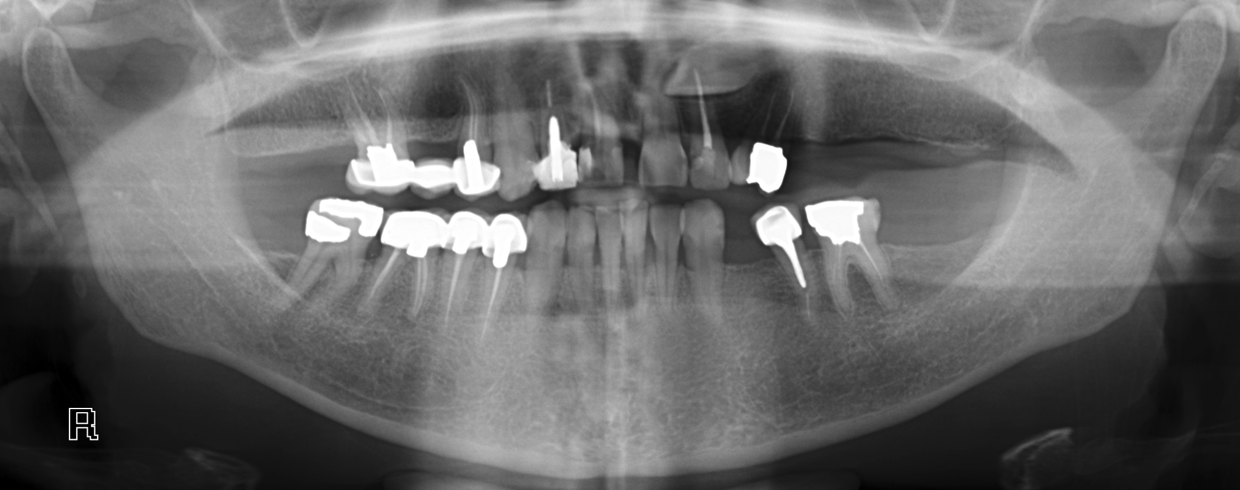
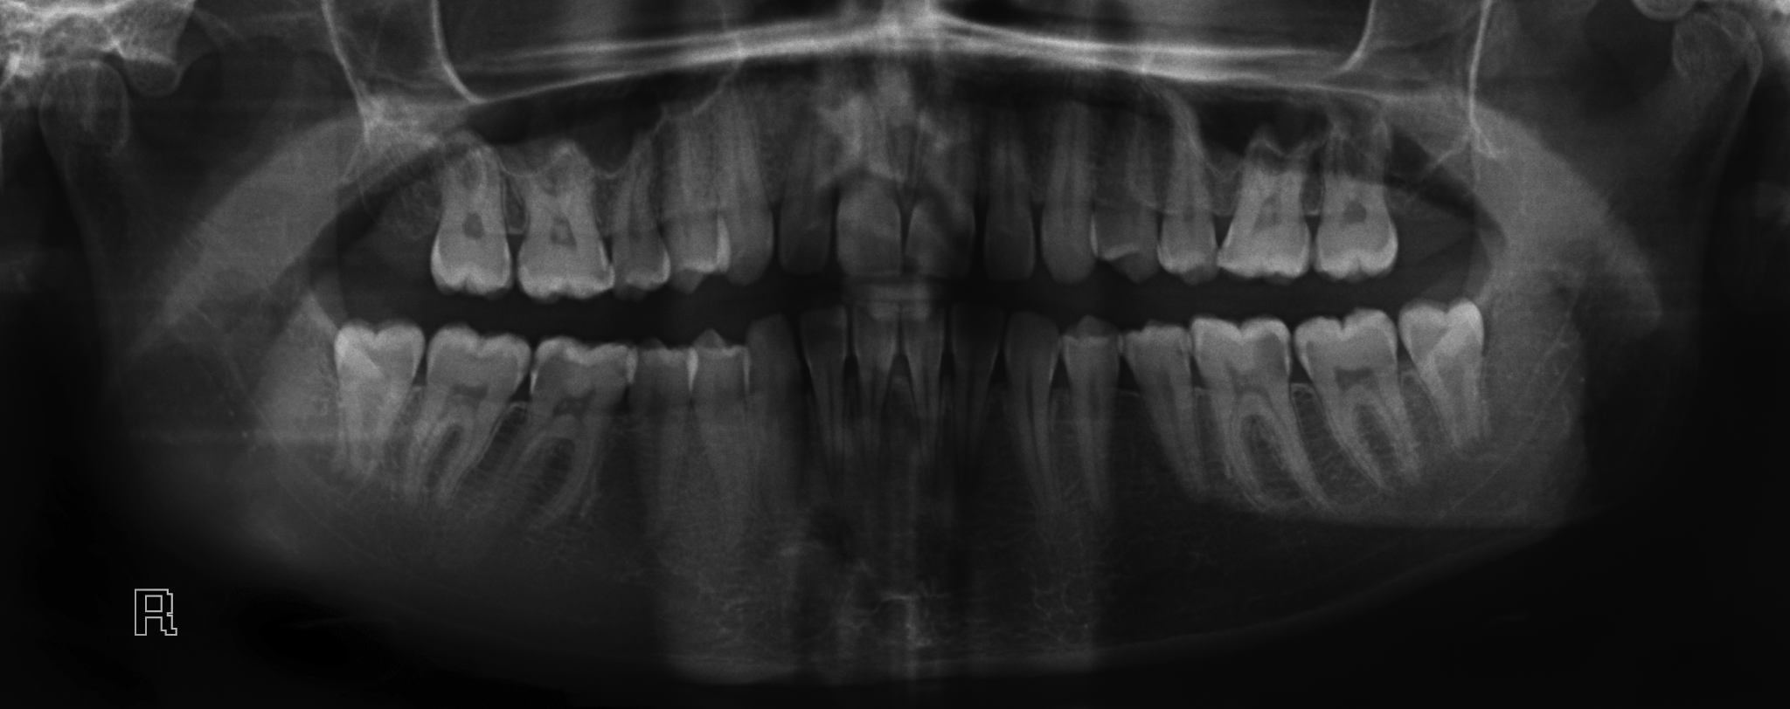
Why X-ray and what are some problems
X-ray images
Grayscale
Overly Bright
Overly Dark
Notes:
Output Result

Slide 7
Expected
Input and Output

Slide 8
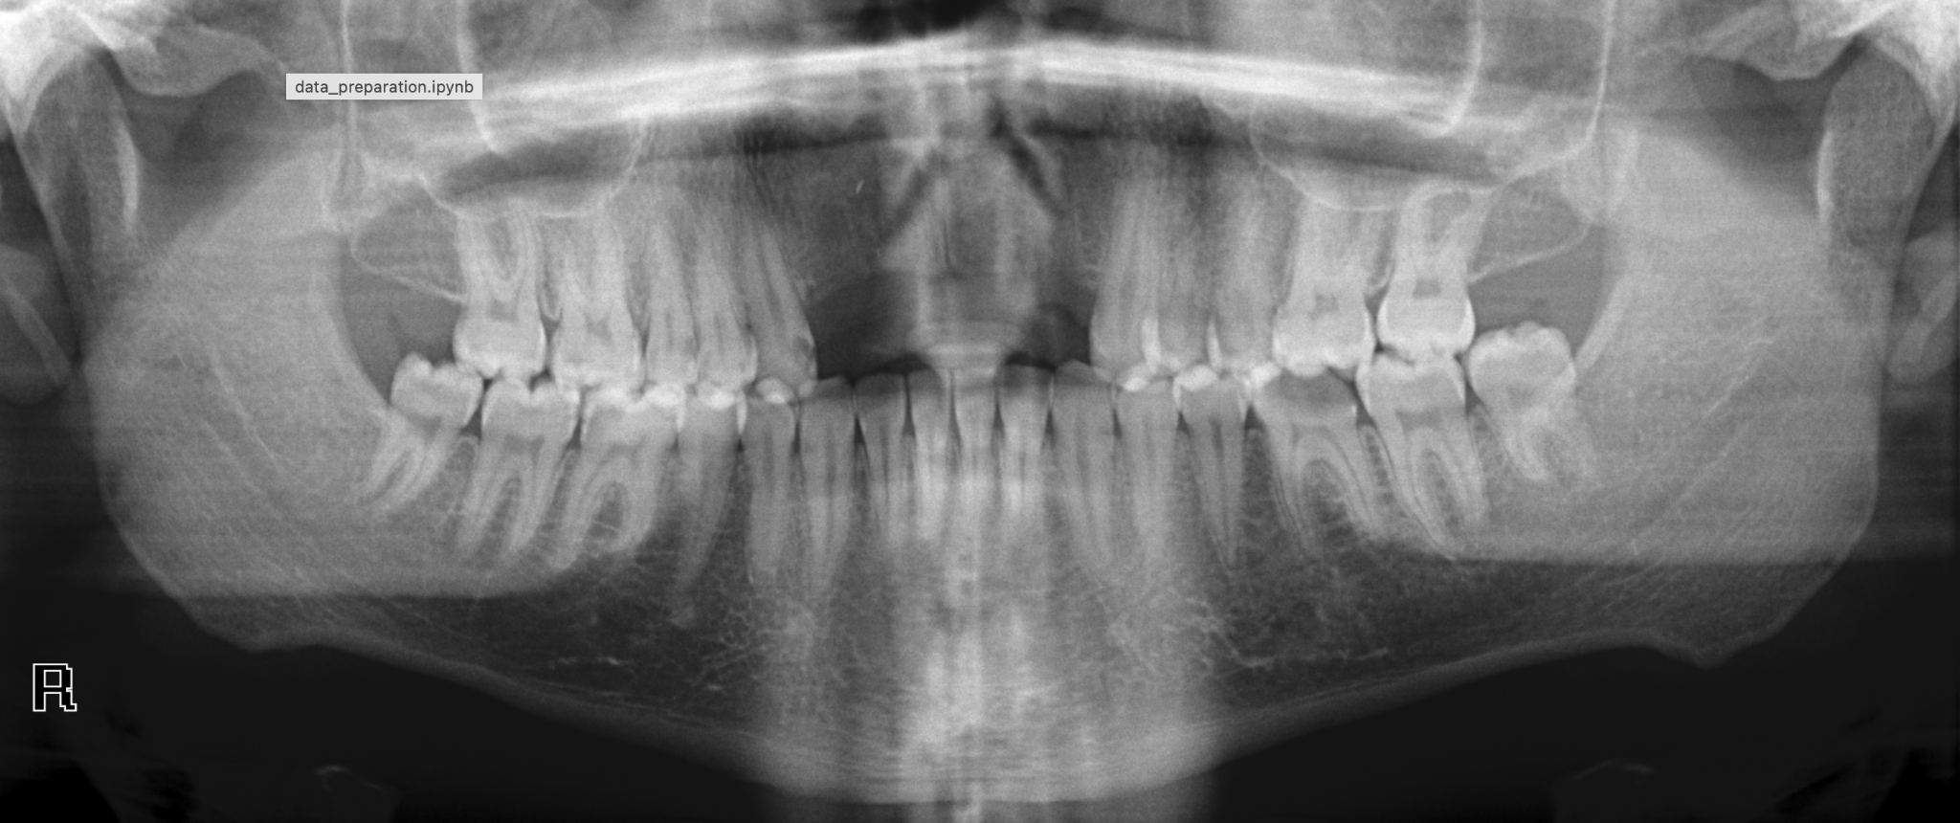
Different Input Images Example

Slide 9
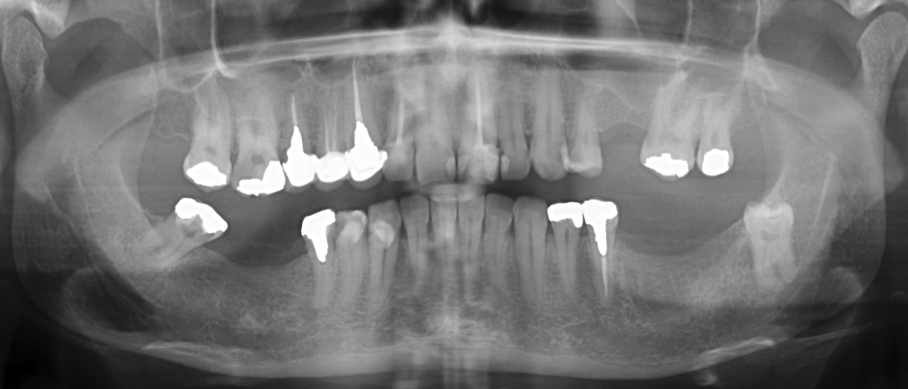
Different Input Images Example

Slide 10
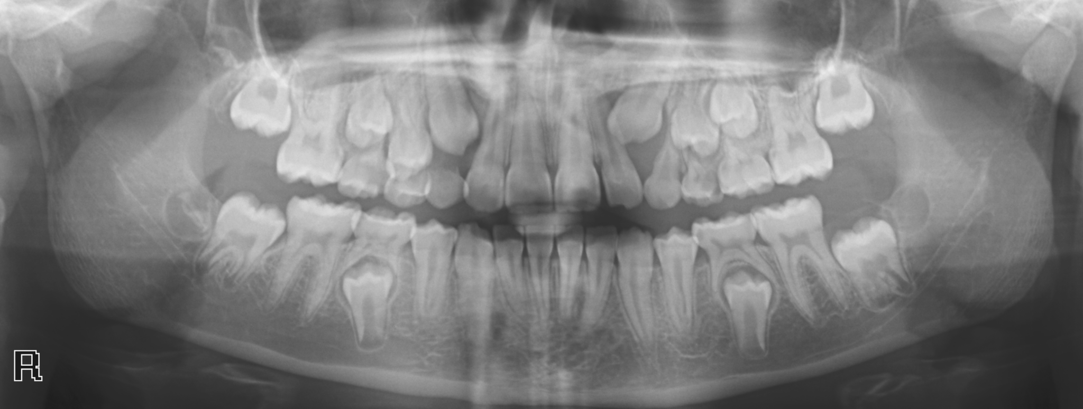

Slide 11
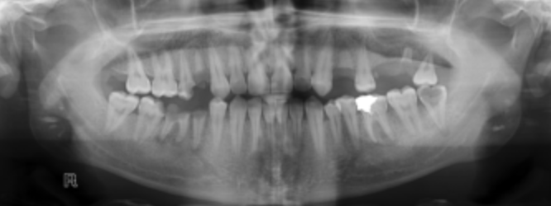
Input Unmasked Image
Notes:
Input Image

Slide 12
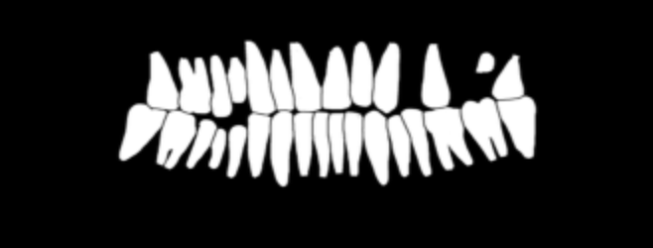
Input Masked Image

Slide 13
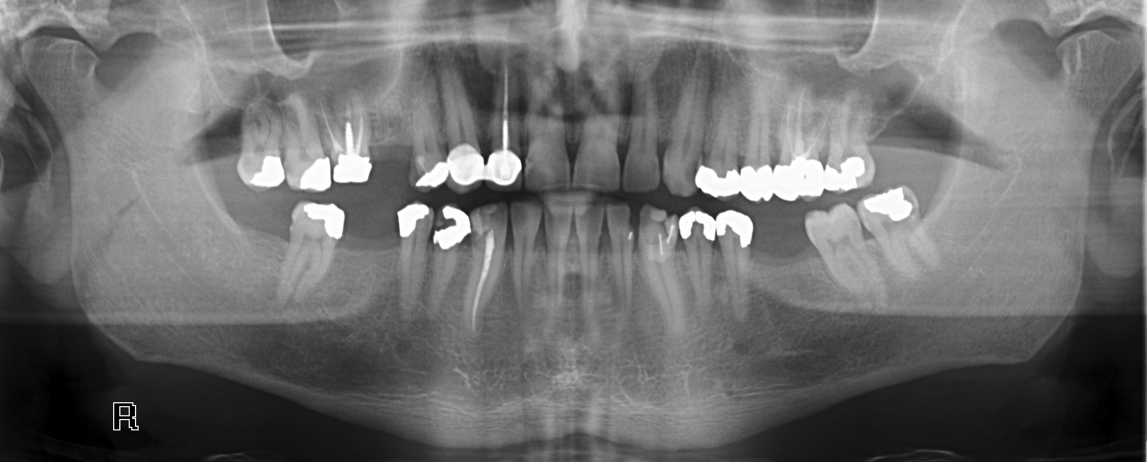
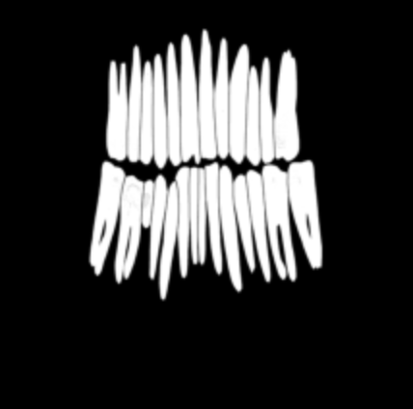
Color
&
Number Labeling
Output Image

Slide 14
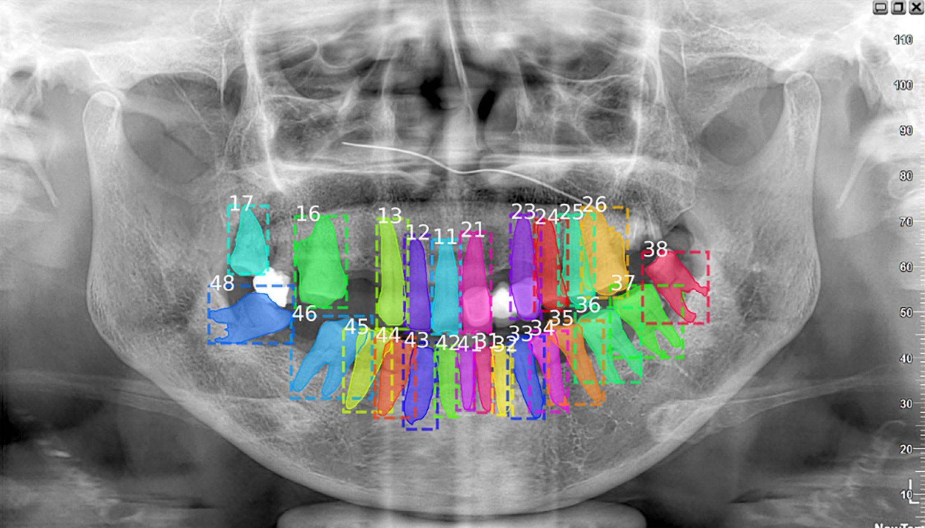

Slide 15
Data Collecting
&
Pre-Process Images
Notes:
Collecting data, introduce the two folders(unmasked and masked); Pre-process Image to 1 channel

Slide 16
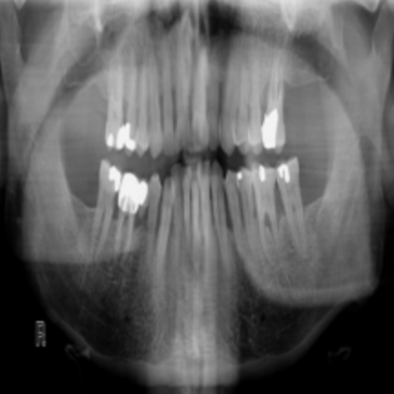
After pre-process, 3104*1200, 1 channel
Notes:
*Click this page to show the masked result during presentation

Slide 17
Dataset
&
DataLoader
Notes:
Yuting’s section

Slide 18
Dataset and Data-Loader
Rename and Merge Files
sklearn
split train and valid
Training data Augmentation
random horizontal flip
random vertical flip
random rotation
normalize
Dictionary to store pairs: ‘image’, ‘annotation’

Slide 19
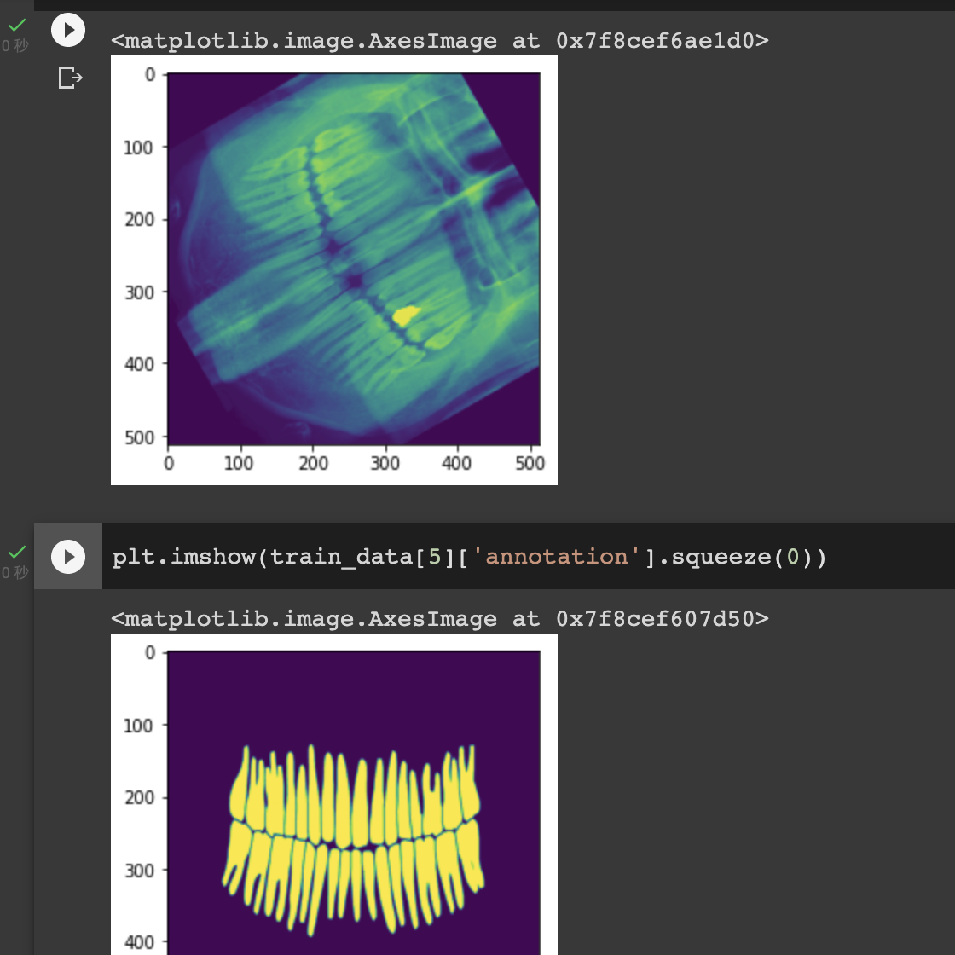
Normalize Images
Feed into three Data-Loaders
Batch-size=2
Shuffle=True

Slide 20
Model Development
&
Training and Testing

Slide 21
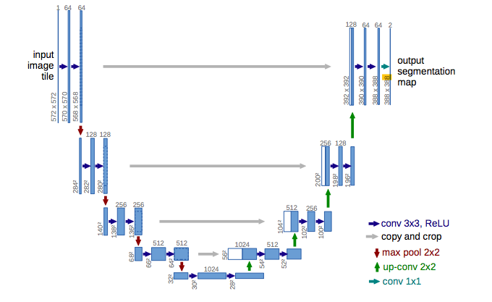
Model
Unet
Previous experience with unet
Double Conv
TConv
Train and test for 150 epoches
Architecture of U-Net based on the paper by Olaf Ronneberger
from Cornell University

Slide 22
Loss
Train vs Test

Slide 23
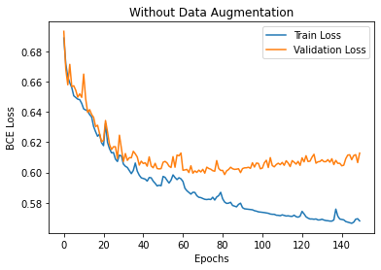
Loss
BCE loss
Train vs Validation Loss
Train vs Test Loss

Slide 24
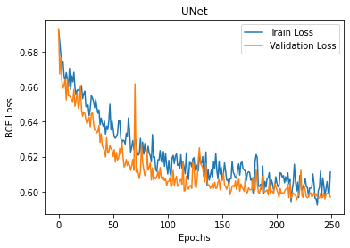
Loss
BCE loss
Train vs Validation Loss
Train vs Test Loss

Slide 25
Visualization of Segmented Result
&
More Information*

Slide 26
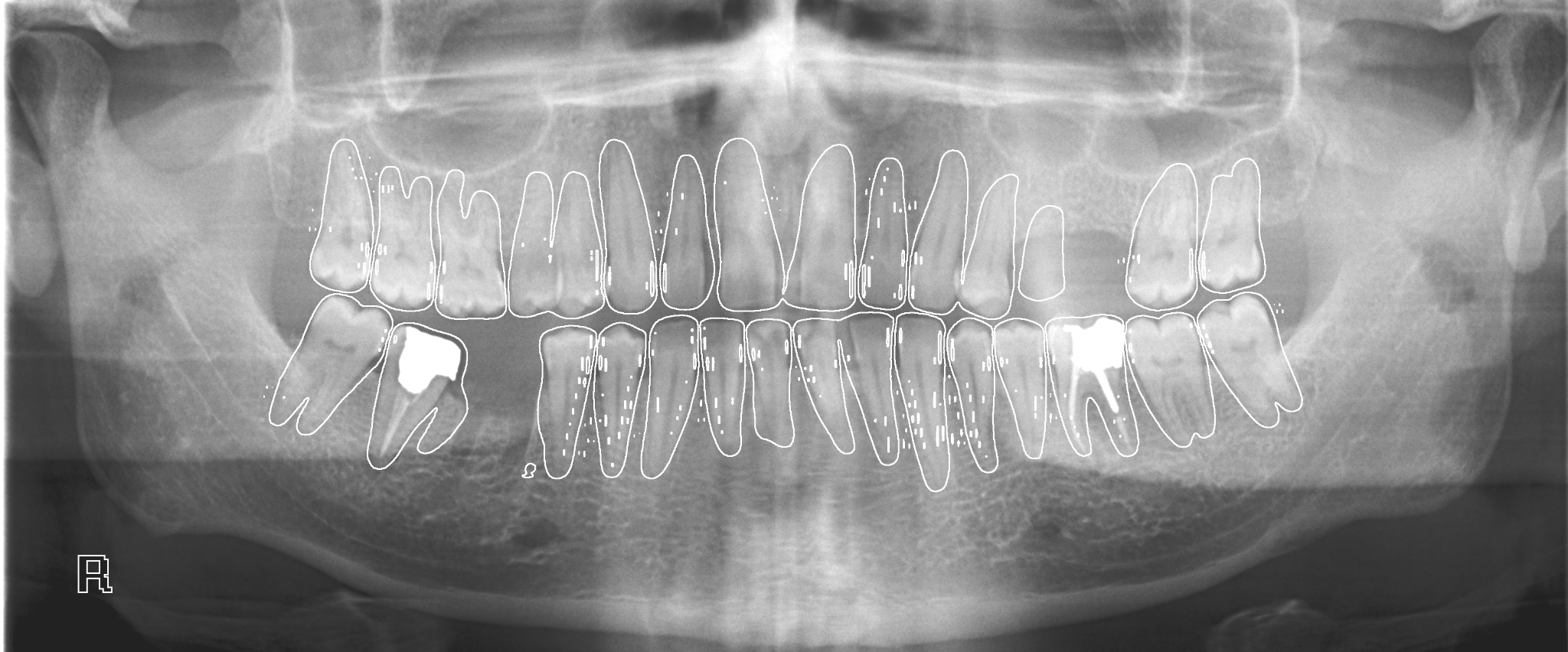
Notes:
*Watershed Segmentation

Slide 27
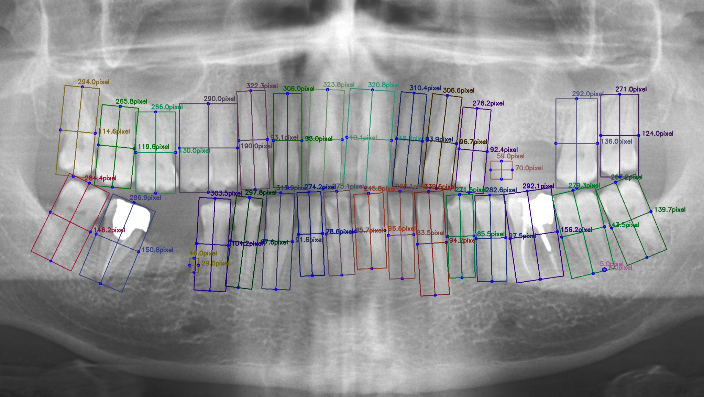

Slide 28
Possible Improvements

Slide 29

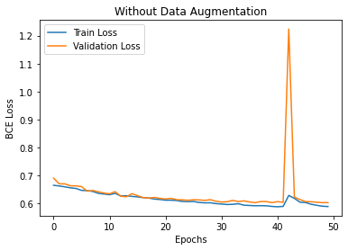
Improvements
Optimization: Model not converging?
ReLU
Weight init
“Average” RGB output
Auto-save checkpoints
Filtering

